Slide 1
Mapping Regional Risks From Climate Change For Rainfed Cultivation

Slide 2
Under the guidance of Dr.J.Rajendra Prasad. Professor.
Team members:
K.R.D.N.Maheswari(15501A1245).
B.Teepthika(15501A1210).
K.Mokshagna Anand(15501A1244).
S.Anirudh(15501A1204).

Slide 3
Contents:
Abstract
Existing System
Proposed System
Software And Hardware Requirements
References

Slide 4
Abstract
Global warming is predicted to increase in the future, with detrimental consequences for rainfed crops that are dependent on natural rainfall .
Many crops grown under particular conditions support the livelihoods of low- income farmers.
It is important to highlight the vulnerability of areas to climate change in order to anticipate potential risks to food security.
The use of more drought-resilient crop varieties and better irrigation infrastructure in these regions may help to reduce these impacts and reduce the vulnerability of farmers dependent on rainfed cropping.

Slide 5
Existing System
Generally, agricultural department stores the information about the different factors that leads to crop yield.
It mainly focuses on production increment and productivity of agricultural crops using environment friendly science and technology.
While ensuring increased net farm income to the farmers through various schemes, programmes and welfare measures.
However, does not investigate the root cause for the decrease in crop yield/agriculture risk. They store the information manually.
This information is not used for future analysis. So, further prediction from previous data is required.

Slide 6
Proposed System
Our project processes the data collected from records of agriculture departments which are stored manually through data visualization tools like weka/tableau/R tool.
The result will be presented in a graphical format for easy understanding of user.
By using this result the agricultural department will make a decision for future crop production.
This will minimizing risk/ increasing the crop production.

Slide 7
Software & Hardware Requirements
Software Requirements:
Data mining tool : R tool
Database : Agriculture Data set(includingyield, productivity,area),and Rainfall Data
Hardware Requirements:
Processor : Pentium-III(or)Higher
Ram : 2GB (or) Higher
Hard disk : Minimum of 1 Gb

Slide 8
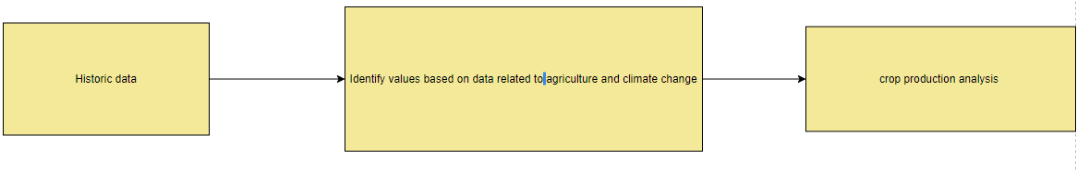
Data Flow Diagram:
Level 0:

Slide 9
Level 1:

Slide 10
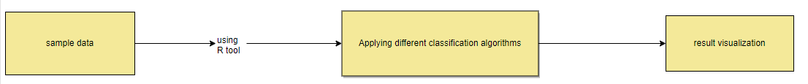
Level 2:

Slide 11
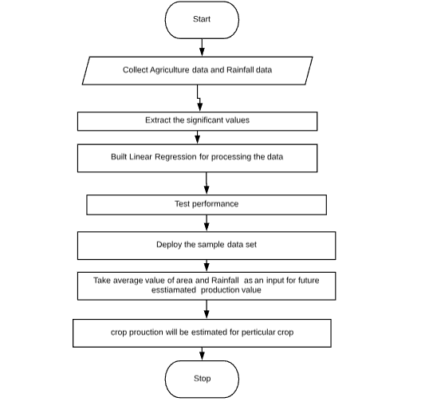
Flow Chart:

Slide 12
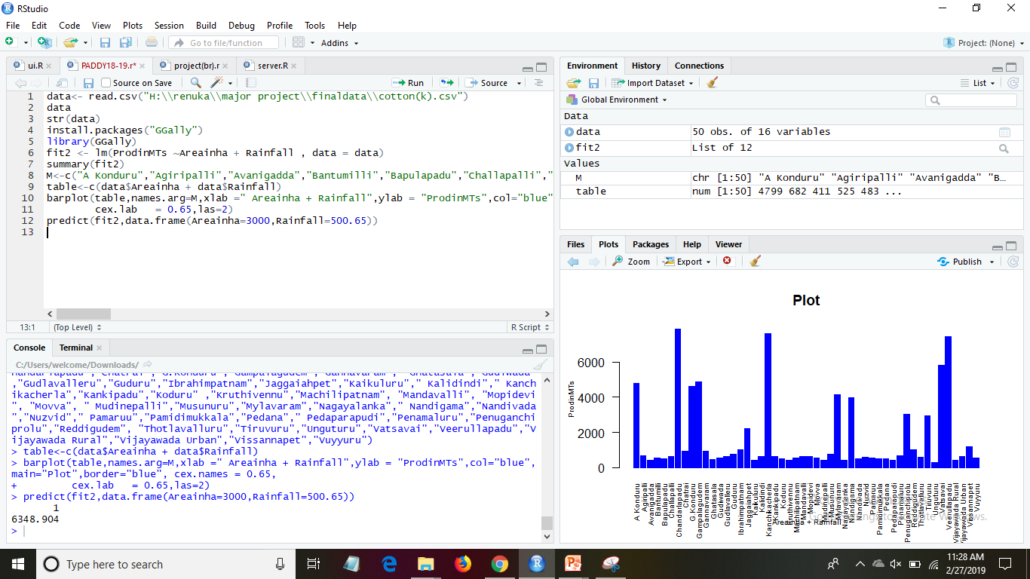

Slide 13
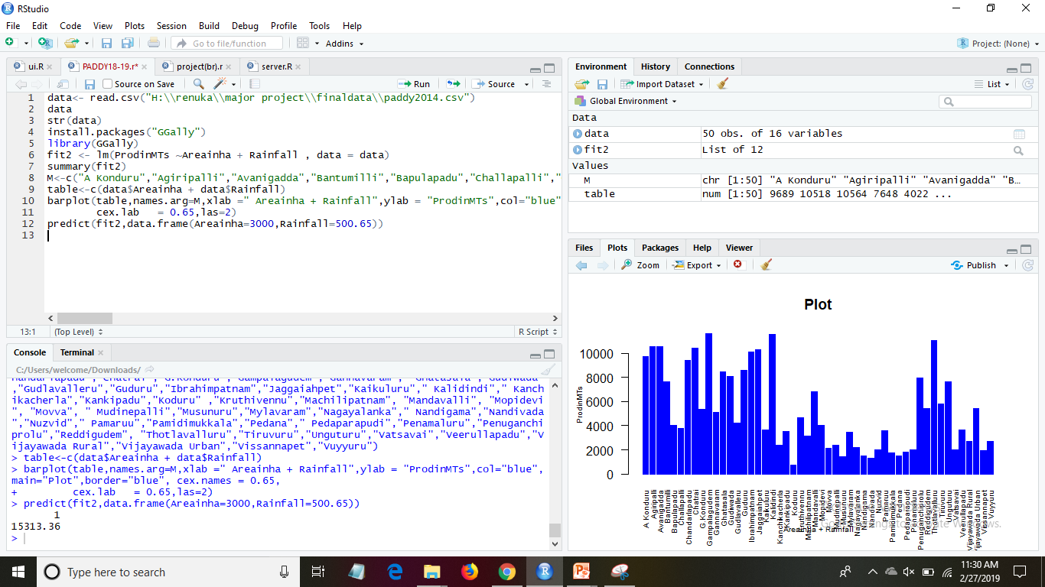

Slide 14
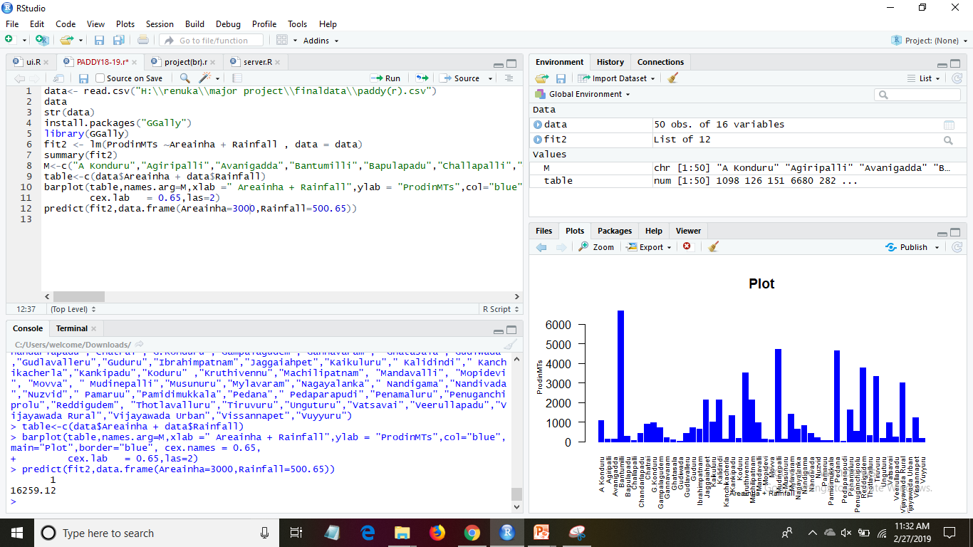

Slide 15
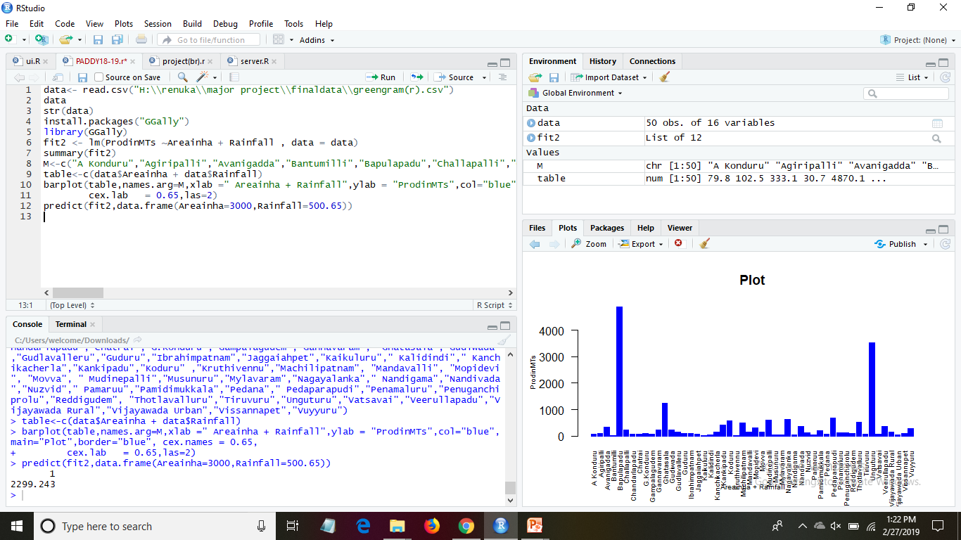

Slide 16
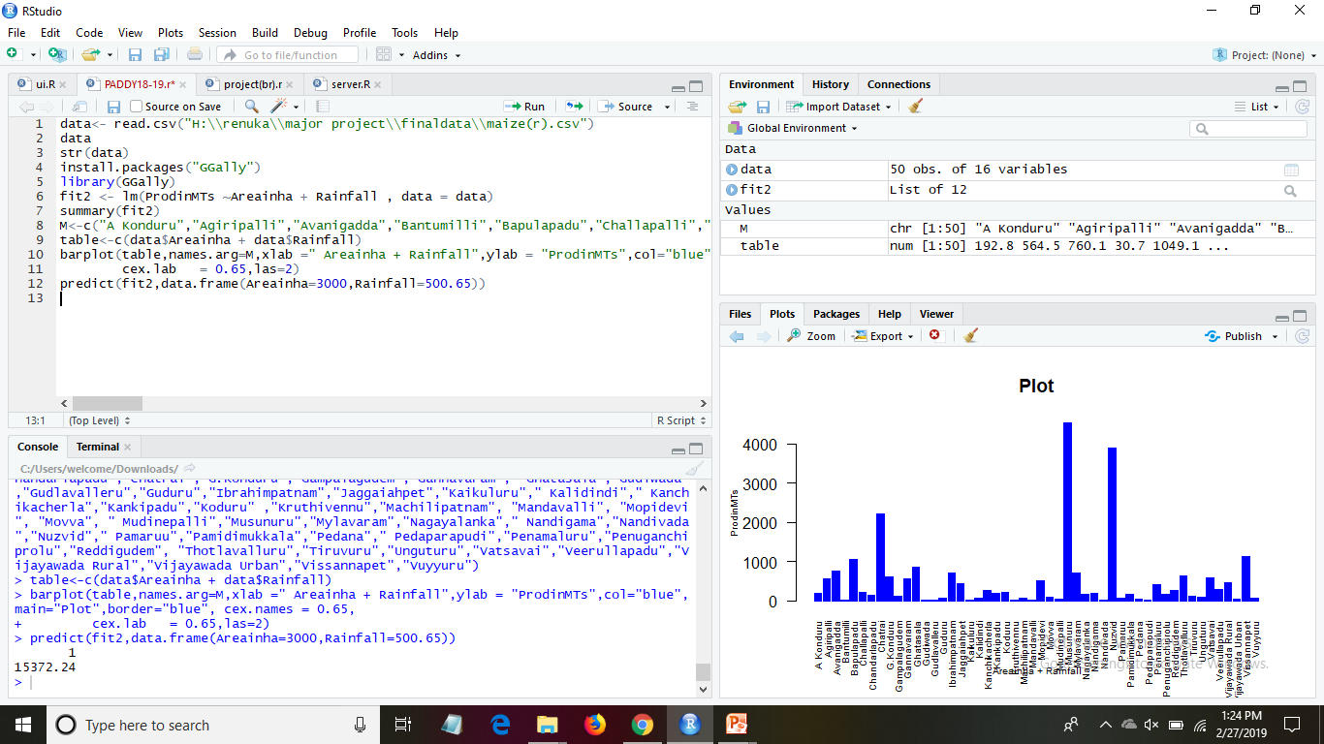

Slide 17
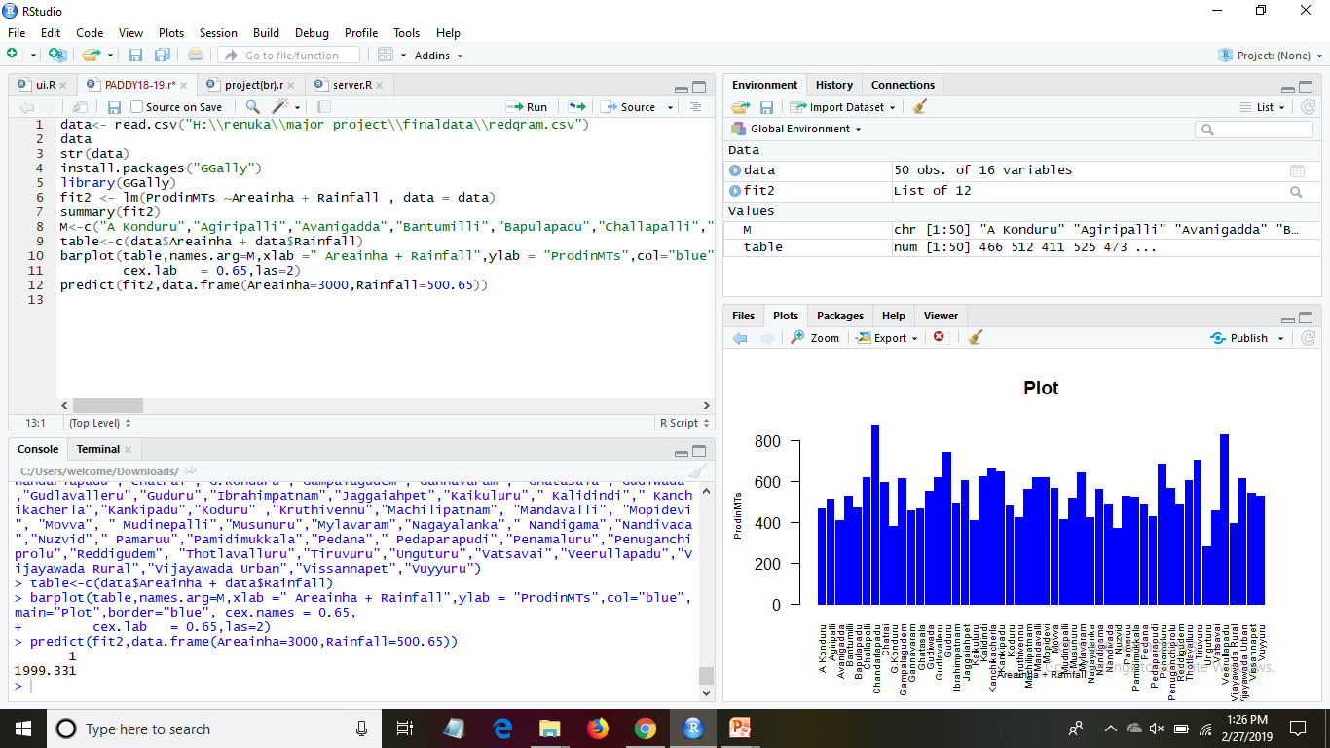

Slide 18
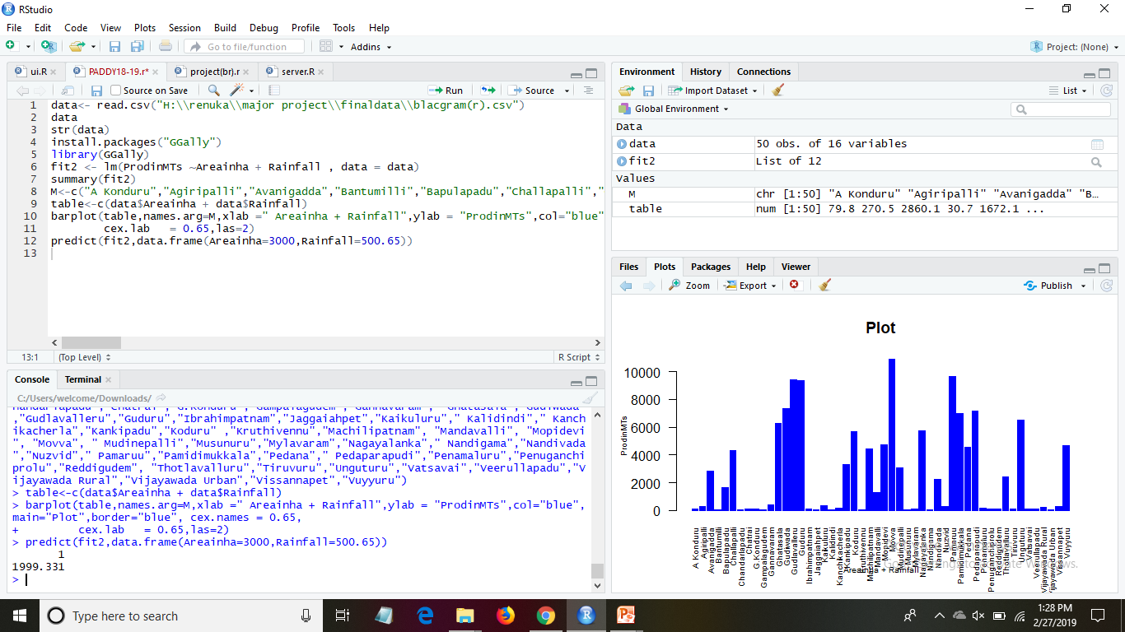

Slide 19
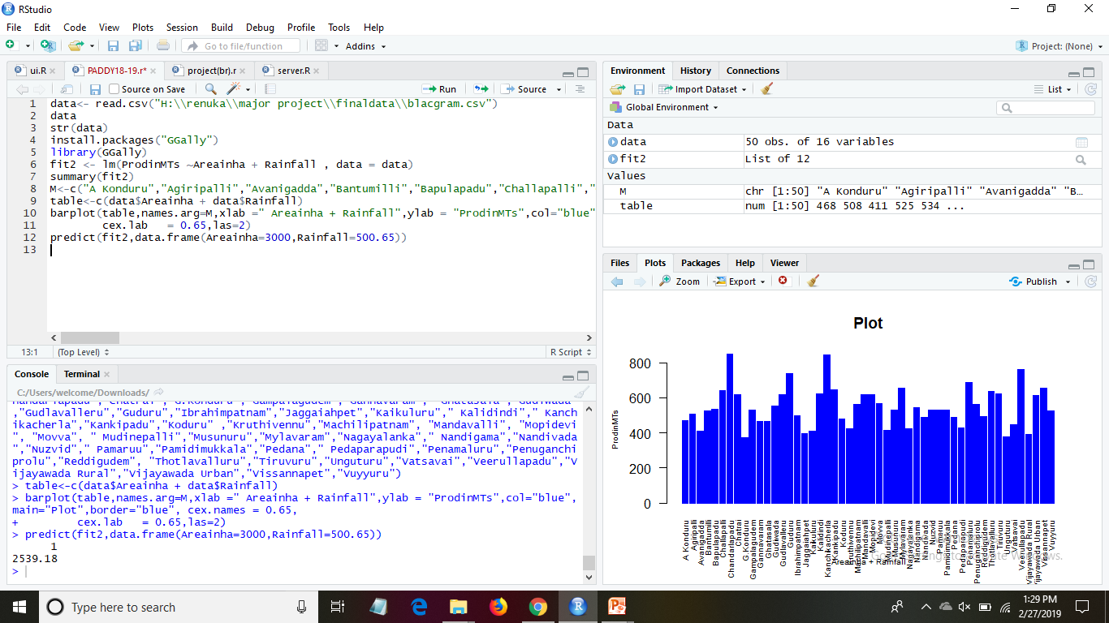

Slide 20
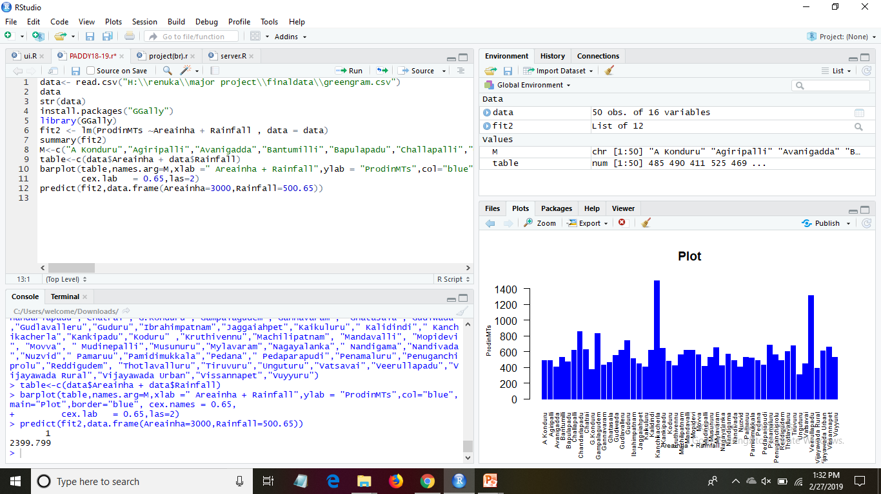

Slide 21
References
Grady Booch, James Rumbaugh, Ivar Jacobson : The Unified Modeling Language User Guide, Pearson Education.Rob Pandey, Pauline Wilcox
Software Engineering, A Precise approach, Pankaj Jalote, Wiley.
Aggarwal et al., 2008 P.K. Aggarwal, K.B. Hebbar, M. Venugopal, S. Rani, A. Biswal, S.P. WaniGlobal theme on agroecosystems quantification of yield gaps in rain-fed rice, wheat, cotton and mustard in IndiaGlobal Theme on Agroecosystems Report No. 43. Andhra Pradesh, India (2008)
Alemaw and Simalenga, 2015B.F. Alemaw, T. SimalengaClimate change impacts and adaptation in rainfed farming systems: a modeling framework for scaling-out climate smart agriculture in sub-Saharan Africa
Am. J. Clim. Chang., 4 (2015), pp. 313-329CrossRefView Record in ScopusAuffhammer et al., 2012M. Auffhammer, V. Ramanathan, J.R. VincentClimate change, the monsoon, and rice yield in India

Slide 22

Any Queries?

Slide 23


